Slide 1

High Impact Skills Development Program
in Artificial Intelligence, Data Science, and Blockchain
Module 3: Data Visualization
Lecture 1: Introduction and Motivation
Instructor: Dr. Arham Muslim
Assistant Professor, SEECS, NUST

Slide 2
Instructor – Dr. Arham Muslim
Educational Background
Professional Experience
Degree | Specialization | University | Country
Ph.D. | Computer Science | RWTH Aachen | Germany
M.Sc. | Software Systems Engineering | RWTH Aachen | Germany
B.Sc. | Software Engineering | UET Taxila | Pakistan
Designation | Organization | Years | Country
Assistant Professor | NUST | Joined Aug 2020 | Pakistan
Senior Researcher | University of Duisburg-Essen | 2.5 year | Germany
Research Assistant / Software Engineer | RWTH Aachen University | 6 year | Germany
Software Developer | Fraunhofer IPT | 3 year | Germany
Software Developer | Zultec | 1 year | Saudi Arabia

Slide 3
Module Tentative Outline
Day | Theoretical Foundations | Hands-on Labs
01 | Introduction to data and information visualization Overview of visualization tools and techniques | Getting started with MS Excel - Creating basic charts and graphs. Pivot Tables
02 | Understanding data and attribute types Building block of Visual Encoding: marks and channels Expressiveness and effectiveness principles | Getting started with Tableau – Creating basic charts and graphs
03 | Advanced visualization techniques (heatmaps, network diagrams, adjacency matrix view, treemaps, etc.) | Creating advanced visualizations in Tableau - heatmaps, network diagrams, and treemaps
05 | Interactivity in visualization: navigation techniques, facet Information between multiple views, reducing items and attributes | Interactive and linked Tableau dashboards - Combining multiple charts into a single view and adding interactivity
05 | Creating visualization programmatically: Setting up the environment, code examples | Creating basic and advanced charts and graphs using Python

Slide 4

Today’s Agenda
What is Data/Information Visualization?
Why Data/Info Vis is Important?
Definition and its Rationale
Understanding Limited Resources
Available Tools and Techniques

Slide 5
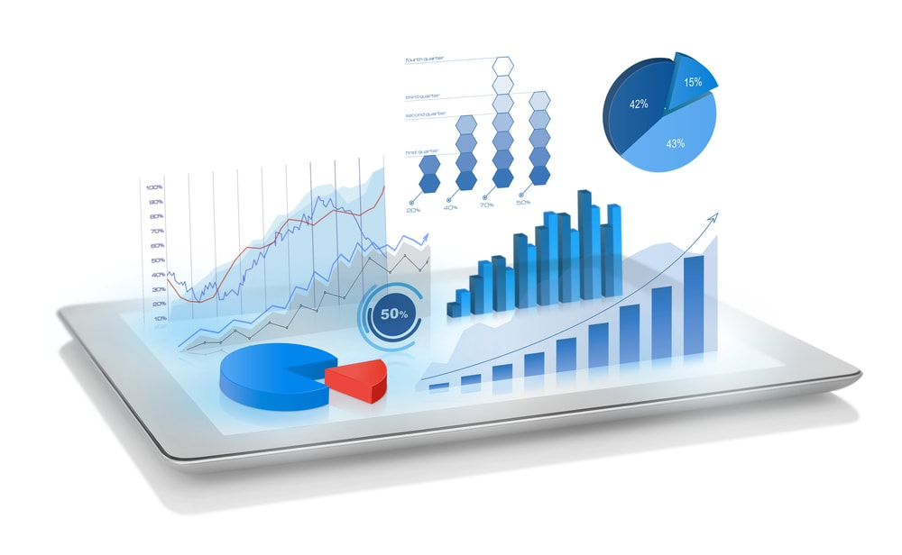
What is Data Visualization?
The representation of data through use of common graphics, such as charts, infographics, and even animations. (IBM)

Slide 6
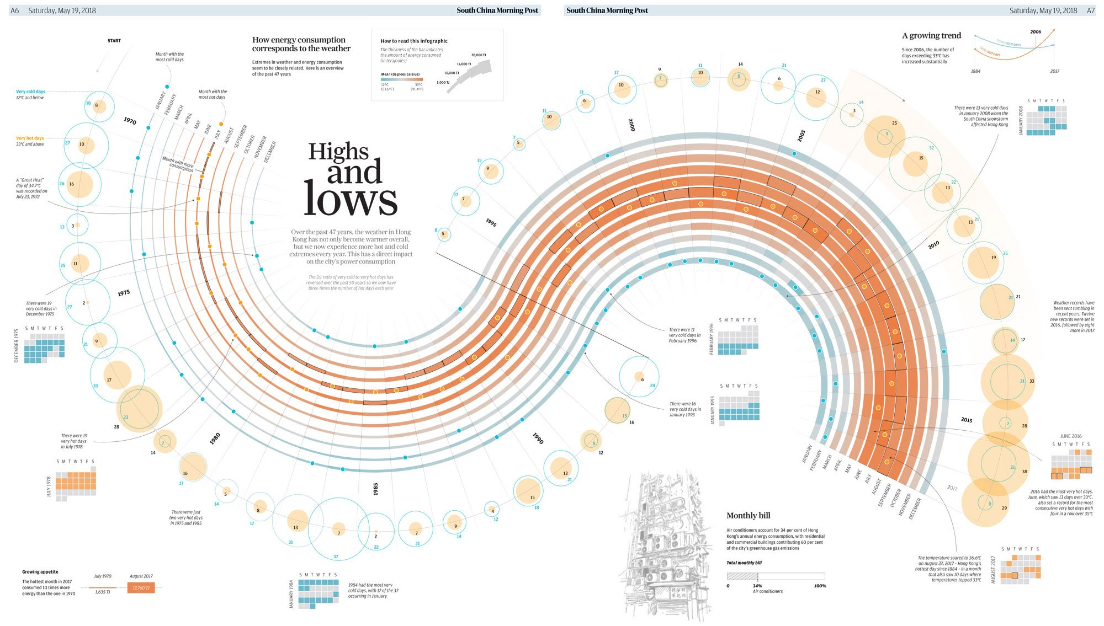
https://multimedia.scmp.com/culture/article/SCMP-printed-graphics-memory/lonelyGraphics/201805A173.html

Slide 7
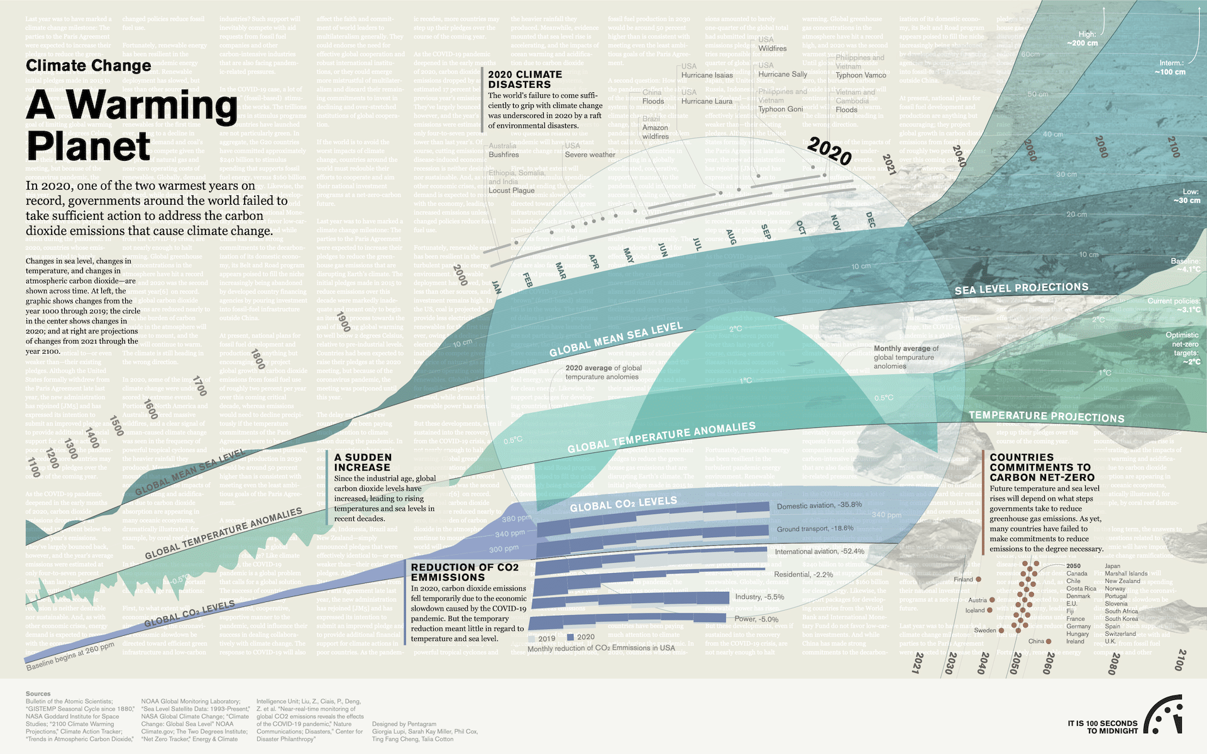
https://thebulletin.org/doomsday-clock/datavisualizations/#climate

Slide 8
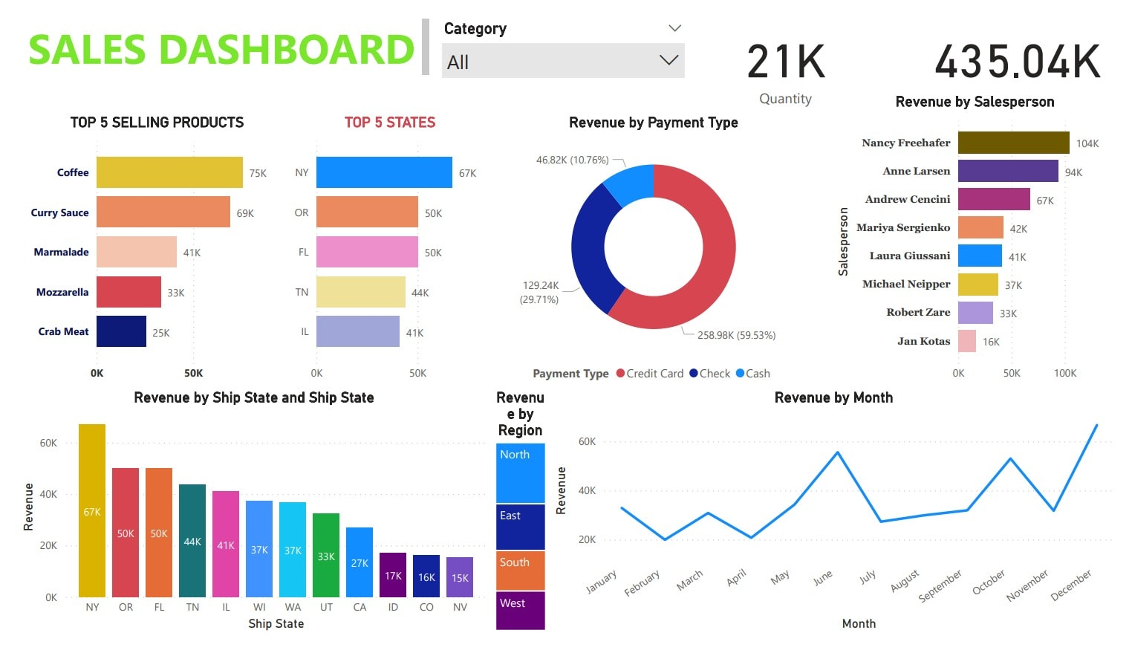
https://www.fiverr.com/gajendersing708/make-dashboard-data-clearning-prediction

Slide 9

Data vs. Information
Unorganized and unrefined facts | Processed, organized data presented in a meaningful context
An individual unit that contains raw materials which do not carry any specific meaning | A group of data that collectively carries a logical meaning
Data doesn’t depend on information | Information depends on data
Raw data alone is insufficient for decision making | Information is sufficient for decision making

Slide 10

What is Information Visualization?
Information visualization (aka InfoVis) is the process of representing data in a visual and meaningful way so that a user can better understand it (Wikipedia)

Slide 11
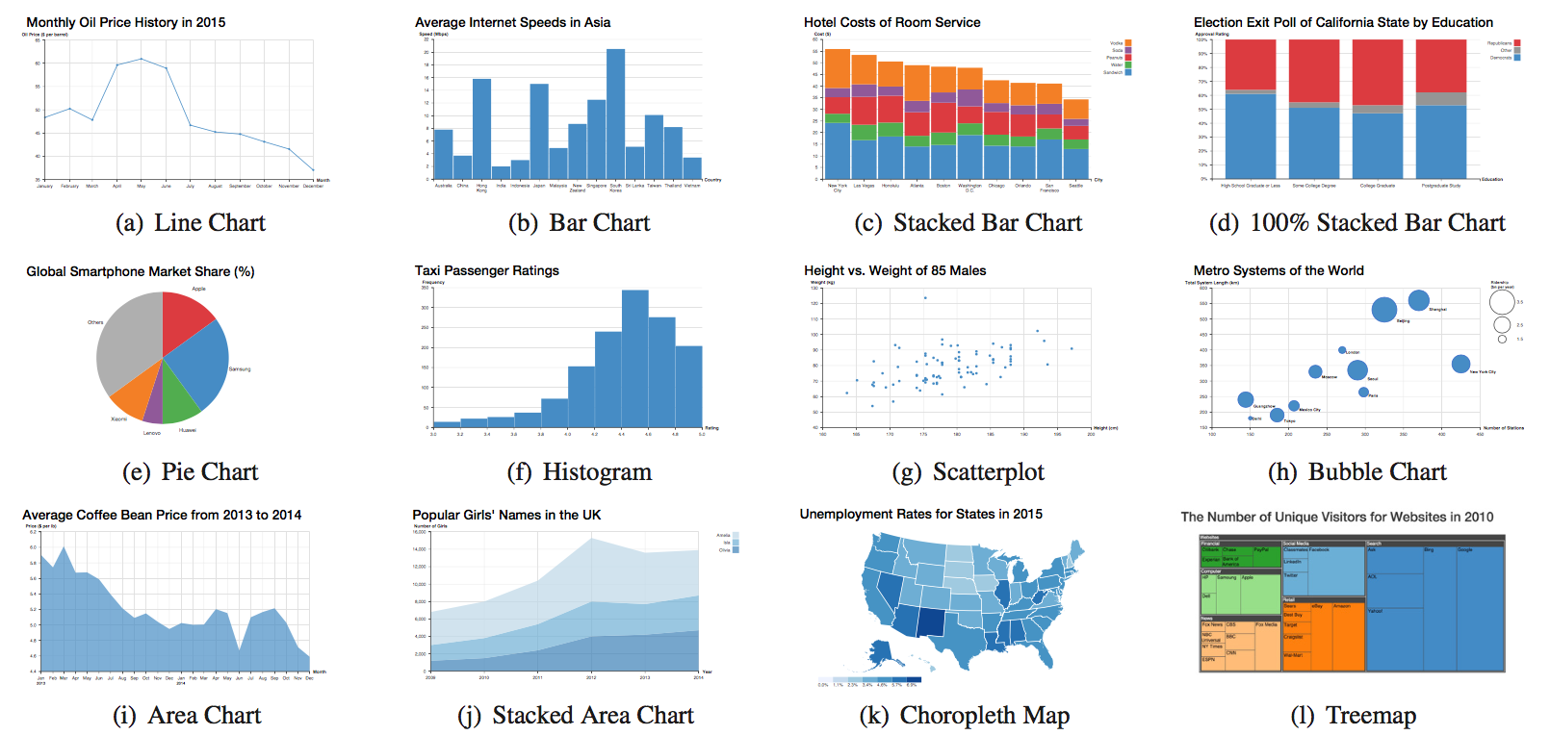
Examples
https://www.bckwon.com/publication/vlat

Slide 12
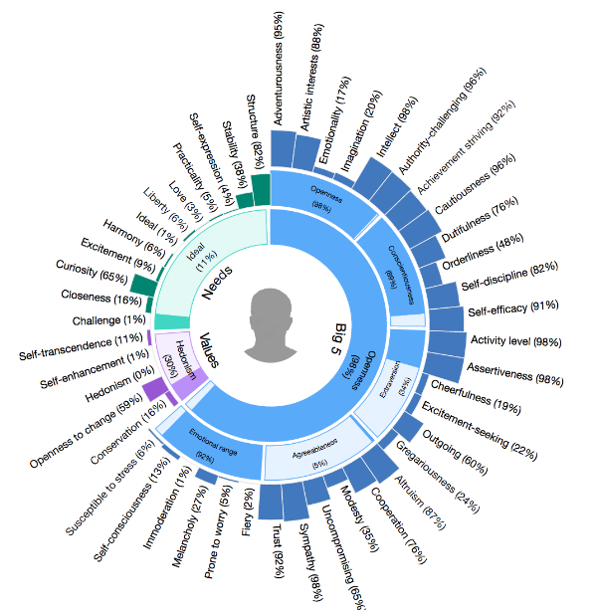
Examples
https://www.npmjs.com/package/personality-sunburst-chart
Sunburst Chart

Slide 13
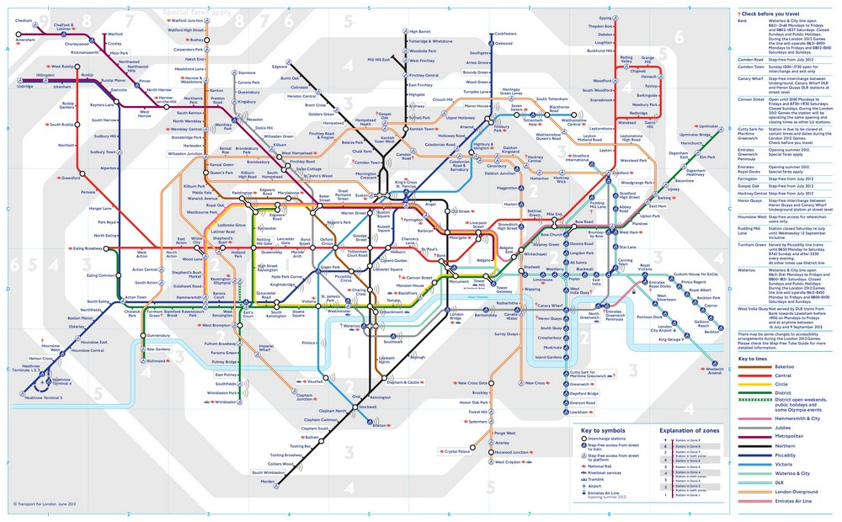
Examples
https://tfl.gov.uk/maps/track

Slide 14
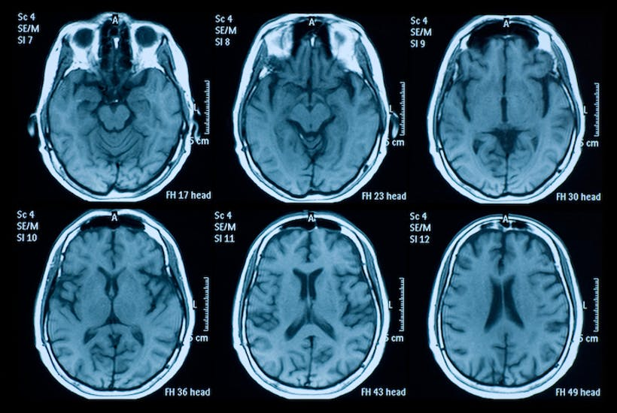
Examples
https://vitalsustenance.com/2017/02/08/mri-brain-scan-elevated-prolactin/

Slide 15
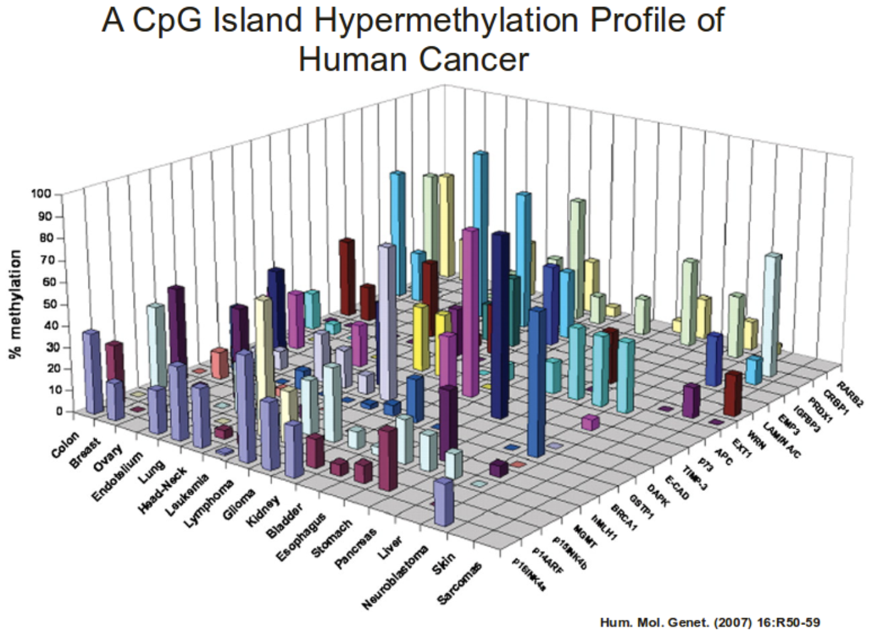
Examples

Slide 16
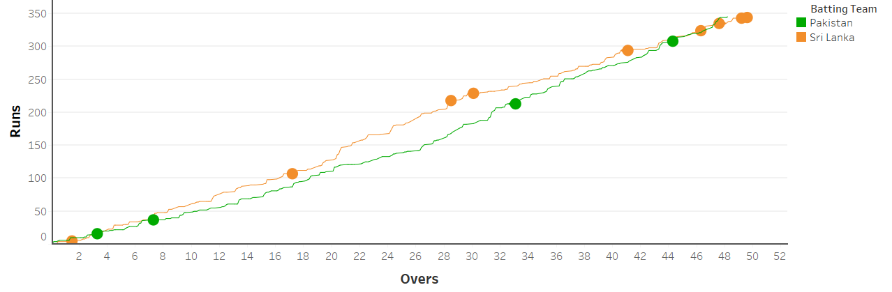
Why Data Vis is Important?
Overs | 0.1 | 0.2 | 0.3 | 0.4 | 0.5 | 0.6 | 1.1 | 1.2 | 1.3 | 1.4 | 1.5 | 1.6 | 1.7 | 1.8 | … | 47.4 | 47.5 | 47.6 | 48.1 | 48.2 | 48.3 | 48.4 | 48.5 | 48.6 | 49.1 | 49.2 | 49.3 | 49.4 | 49.5 | 49.6
Sri Lanka Runs | 0 | 0 | 0 | 0 | 4 | 4 | 4 | 5 | 5 | 5 | 5 | 5 | 6 | 6 | … | 334 | 335 | 335 | 335 | 337 | 338 | 338 | 339 | 343 | 343 | 343 | 343 | 343 | 344 | 344
Sri Lanka Wickets |  |  |  |  |  |  |  |  |  |  | W |  |  |  | … |  |  | W |  |  |  |  |  |  |  | W |  |  |  | W
Pakistan Runs | 1 | 4 | 4 | 4 | 5 | 6 | 6 | 6 | 6 | 10 | 10 | 10 | 10 | 10 | … | 333 | 334 | 338 | 339 | 343 | 344 | 344 | 345
Pakistan Wickets |  |  |  |  |  |  |  |  |  |  |  |  |  |  |  | W
Visualization generated by Arham Muslim using Tableau Desktop
Dataset Source: https://cricsheet.org/downloads/

Slide 17

Why Data Vis is Important?
Communicate Data/Information Quickly & Effectively
Make Sense of Big and Complicated Data
Exploratory Data Analysis (EDA)
Increase Interest and Engagement with Data
Faster Decision Making

Slide 18
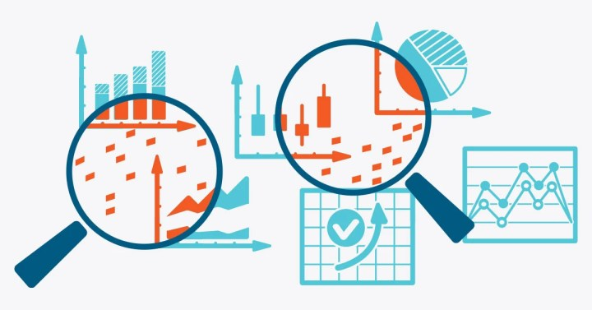
Exploratory Data Analysis (EDA)
Exploratory Data Analysis refers to the critical process of performing initial investigations on data
An approach/philosophy for data analysis that employs a variety of techniques
Statistics
Graphical representations
Not a formal process with a strict set of rules
More of an art than a science
(mean, median, standard deviation, …)
(mostly used)

Slide 19

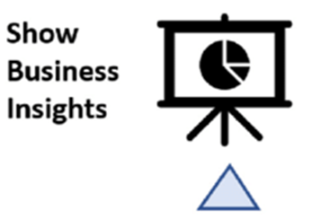
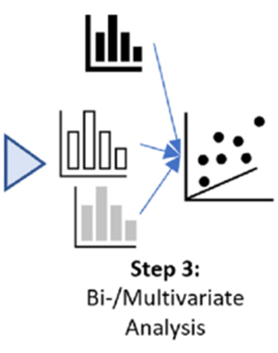
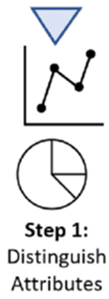
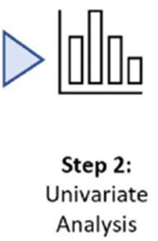
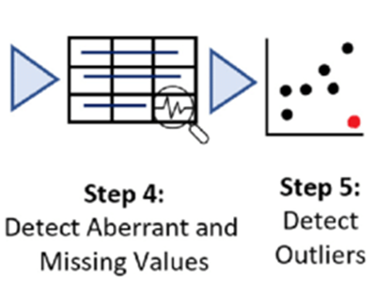
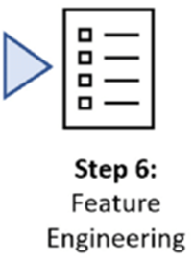
Possible EDA Process

Slide 20
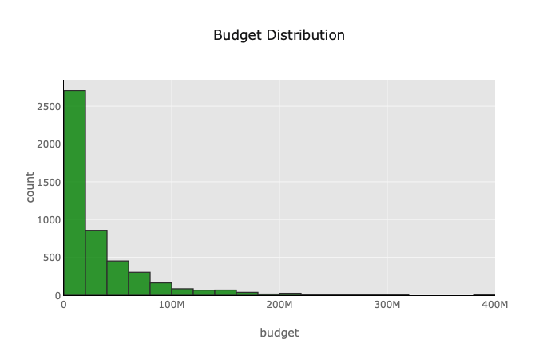
Classification of EDA
Univariate Analysis
Get a deeper understanding of each attribute
Looks at one variable (data column) at a time
Helps with detection of details of attributes in the data:
Centrality (i.e., mean, median, and mode)
Distribution (i.e., range, variance, standard deviation, skewness, and kurtosis) of attributes in the data
Also used to identify missing values or outliers in a dataset
Available idioms
Histogram

Slide 21
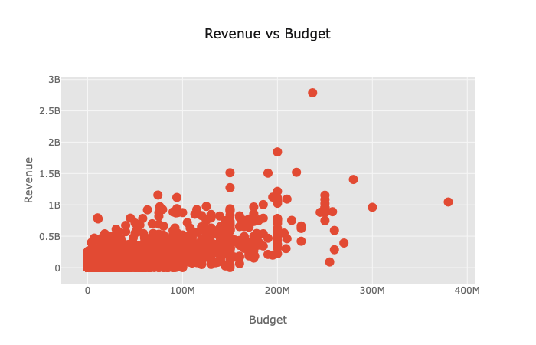
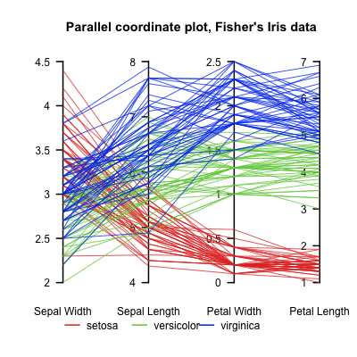
Classification of EDA
Multivariate Analysis
Understand the relationships among different attributes in the dataset
Generate optimal feature combinations for subsequent analysis
Bivariate analysis needs to be performed prior to multivariate analysis
Available idioms
Bivariate Analysis
Scatterplot, Bar Chart,
Line Chart, Box plot
Multivariate Analysis
Parallel coordinates
Small multiples

Slide 22
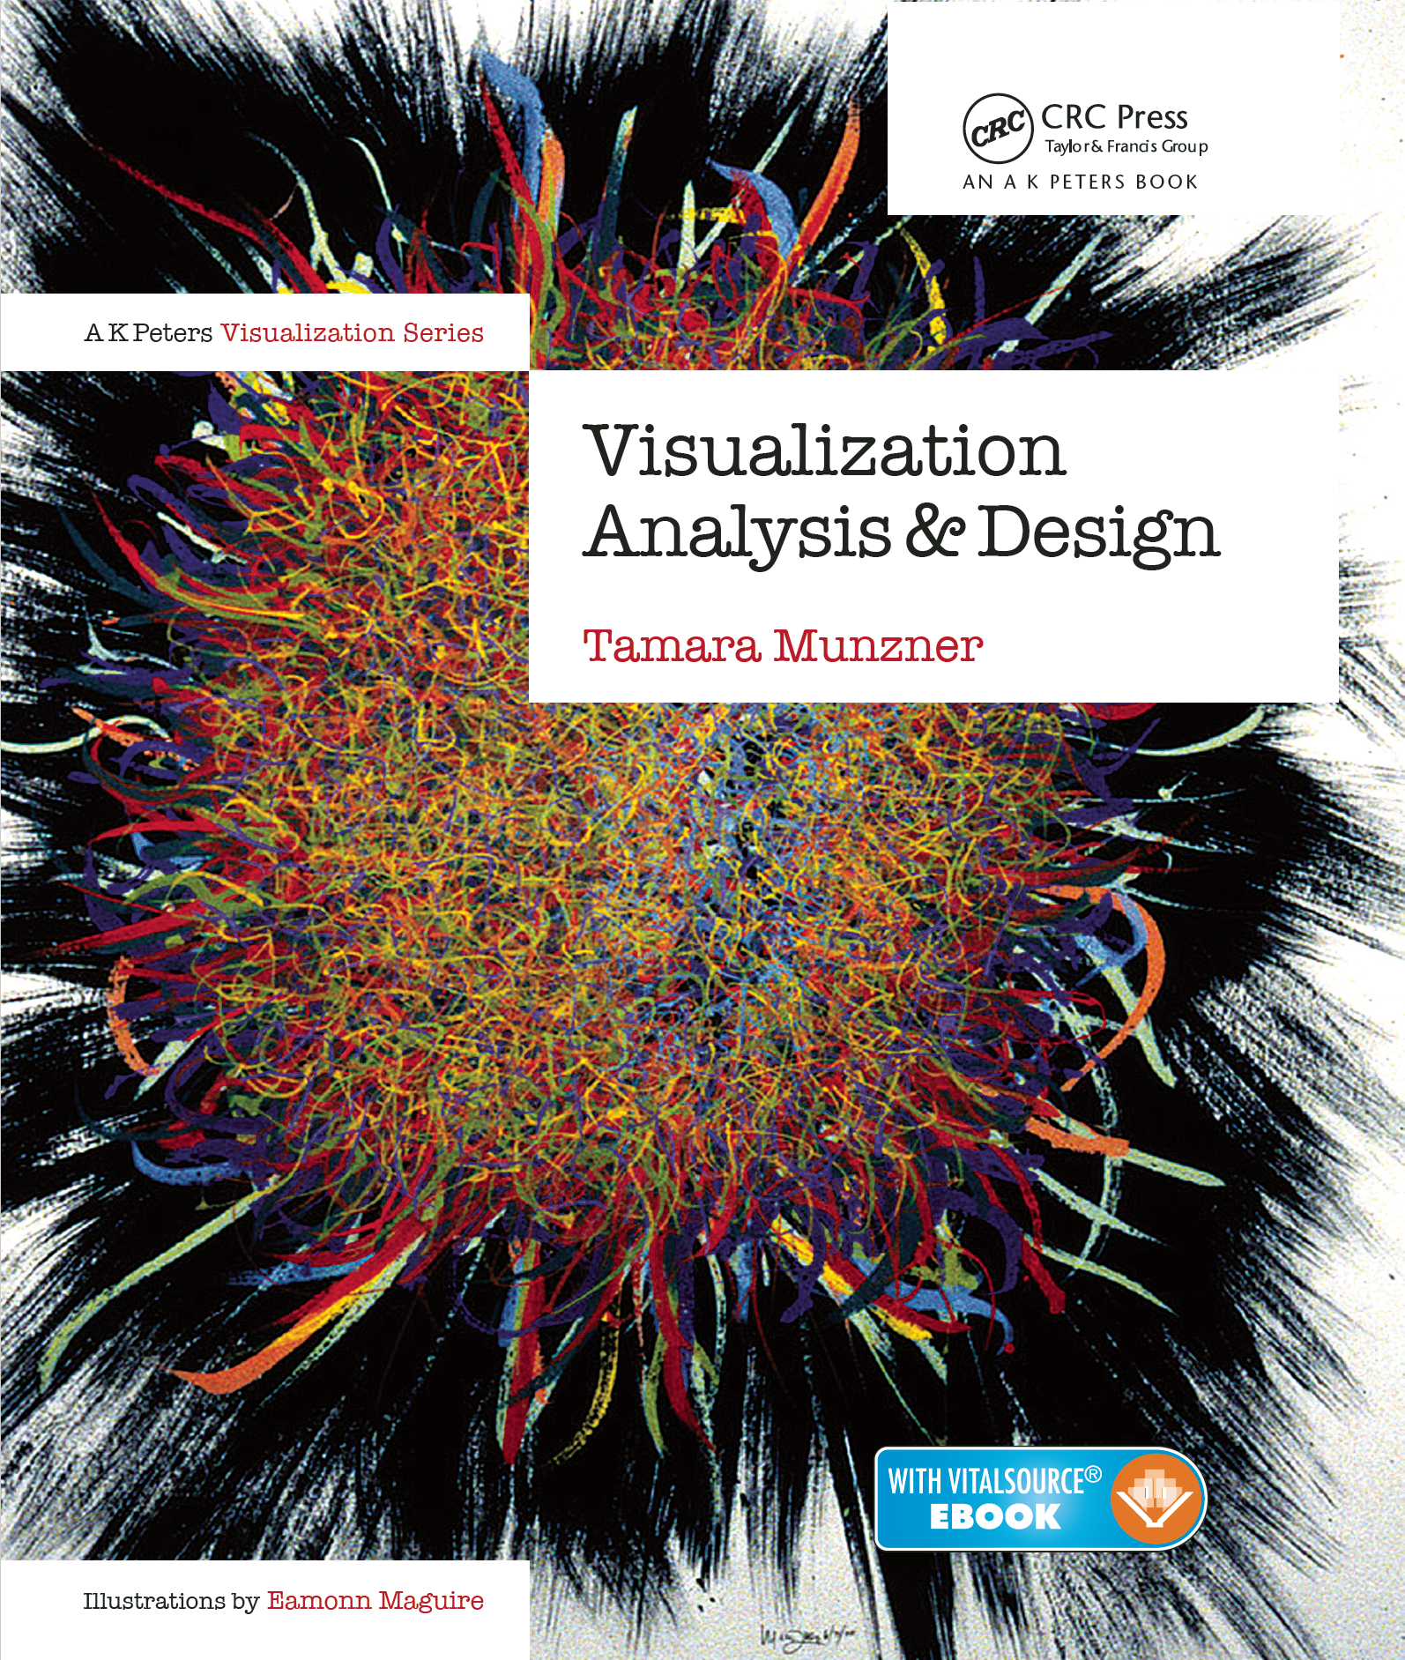
InfoVis - Definition
Computer-based visualization provides visual representations of datasets designed to help people carry out tasks more effectively (Munzner)
Rationale behind different aspects of this definition
Human in the loop
Computer in the loop
Dependency on vision
Visual representation
Represent all the data
Focus on tasks and effectiveness
How to get user requirements?
Resource Limitations

Slide 23
Human in the loop
Visualization is suitable when there is a need to augment human capabilities
Human needs the details
Exploratory data analysis (EDA)
Present/explain known results to others
Steppingstone towards automation
Refine, debug, and set parameters of algorithm

Slide 24
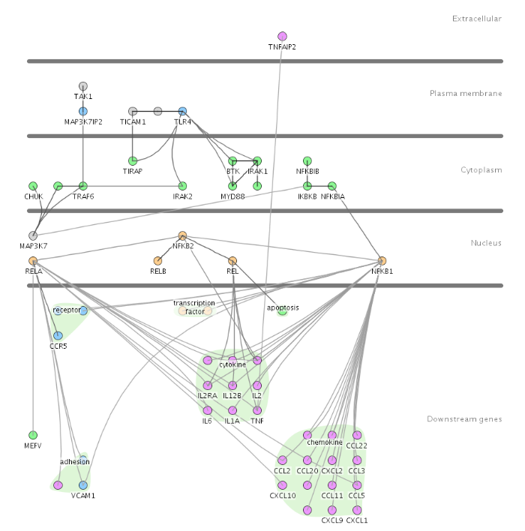
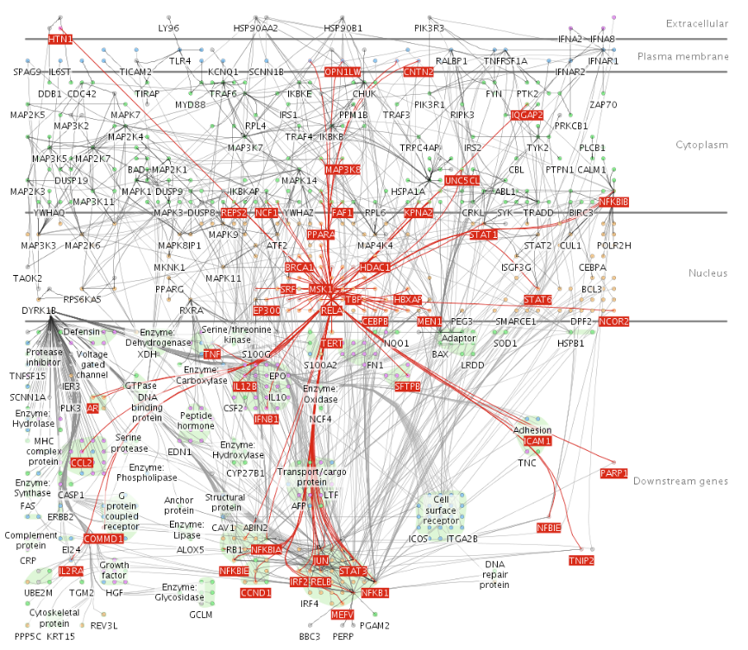
Computer in the loop
Beyond human patience: scale to large datasets, support interactivity

Slide 25
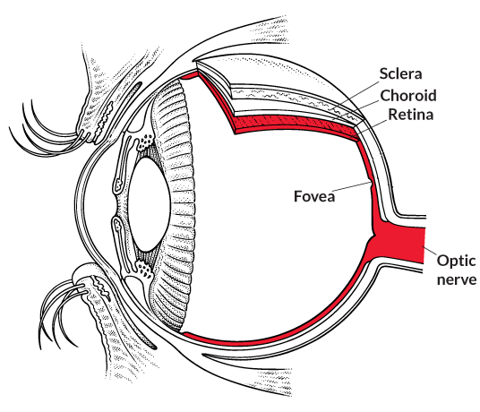
Dependency on Vision
Human visual system is high-bandwidth channel to brain
Overview possible
Subjective experience of seeing everything simultaneously
Sound: lower bandwidth to brain
Overview not supported
Subjective experience of sequential stream
Touch: not easy to record/replay information

Slide 26
Visual Representation
Visual representation: replace cognition with perception
Overs | 0.1 | 0.2 | 0.3 | 0.4 | 0.5 | 0.6 | 1.1 | 1.2 | 1.3 | 1.4 | 1.5 | 1.6 | 1.7 | 1.8 | … | 47.4 | 47.5 | 47.6 | 48.1 | 48.2 | 48.3 | 48.4 | 48.5 | 48.6 | 49.1 | 49.2 | 49.3 | 49.4 | 49.5 | 49.6
Sri Lanka Runs | 0 | 0 | 0 | 0 | 4 | 4 | 4 | 5 | 5 | 5 | 5 | 5 | 6 | 6 | … | 334 | 335 | 335 | 335 | 337 | 338 | 338 | 339 | 343 | 343 | 343 | 343 | 343 | 344 | 344
Sri Lanka Wickets |  |  |  |  |  |  |  |  |  |  | W |  |  |  | … |  |  | W |  |  |  |  |  |  |  | W |  |  |  | W
Pakistan Runs | 1 | 4 | 4 | 4 | 5 | 6 | 6 | 6 | 6 | 10 | 10 | 10 | 10 | 10 | … | 333 | 334 | 338 | 339 | 343 | 344 | 344 | 345
Pakistan Wickets |  |  |  |  |  |  |  |  |  |  |  |  |  |  |  | W

Slide 27
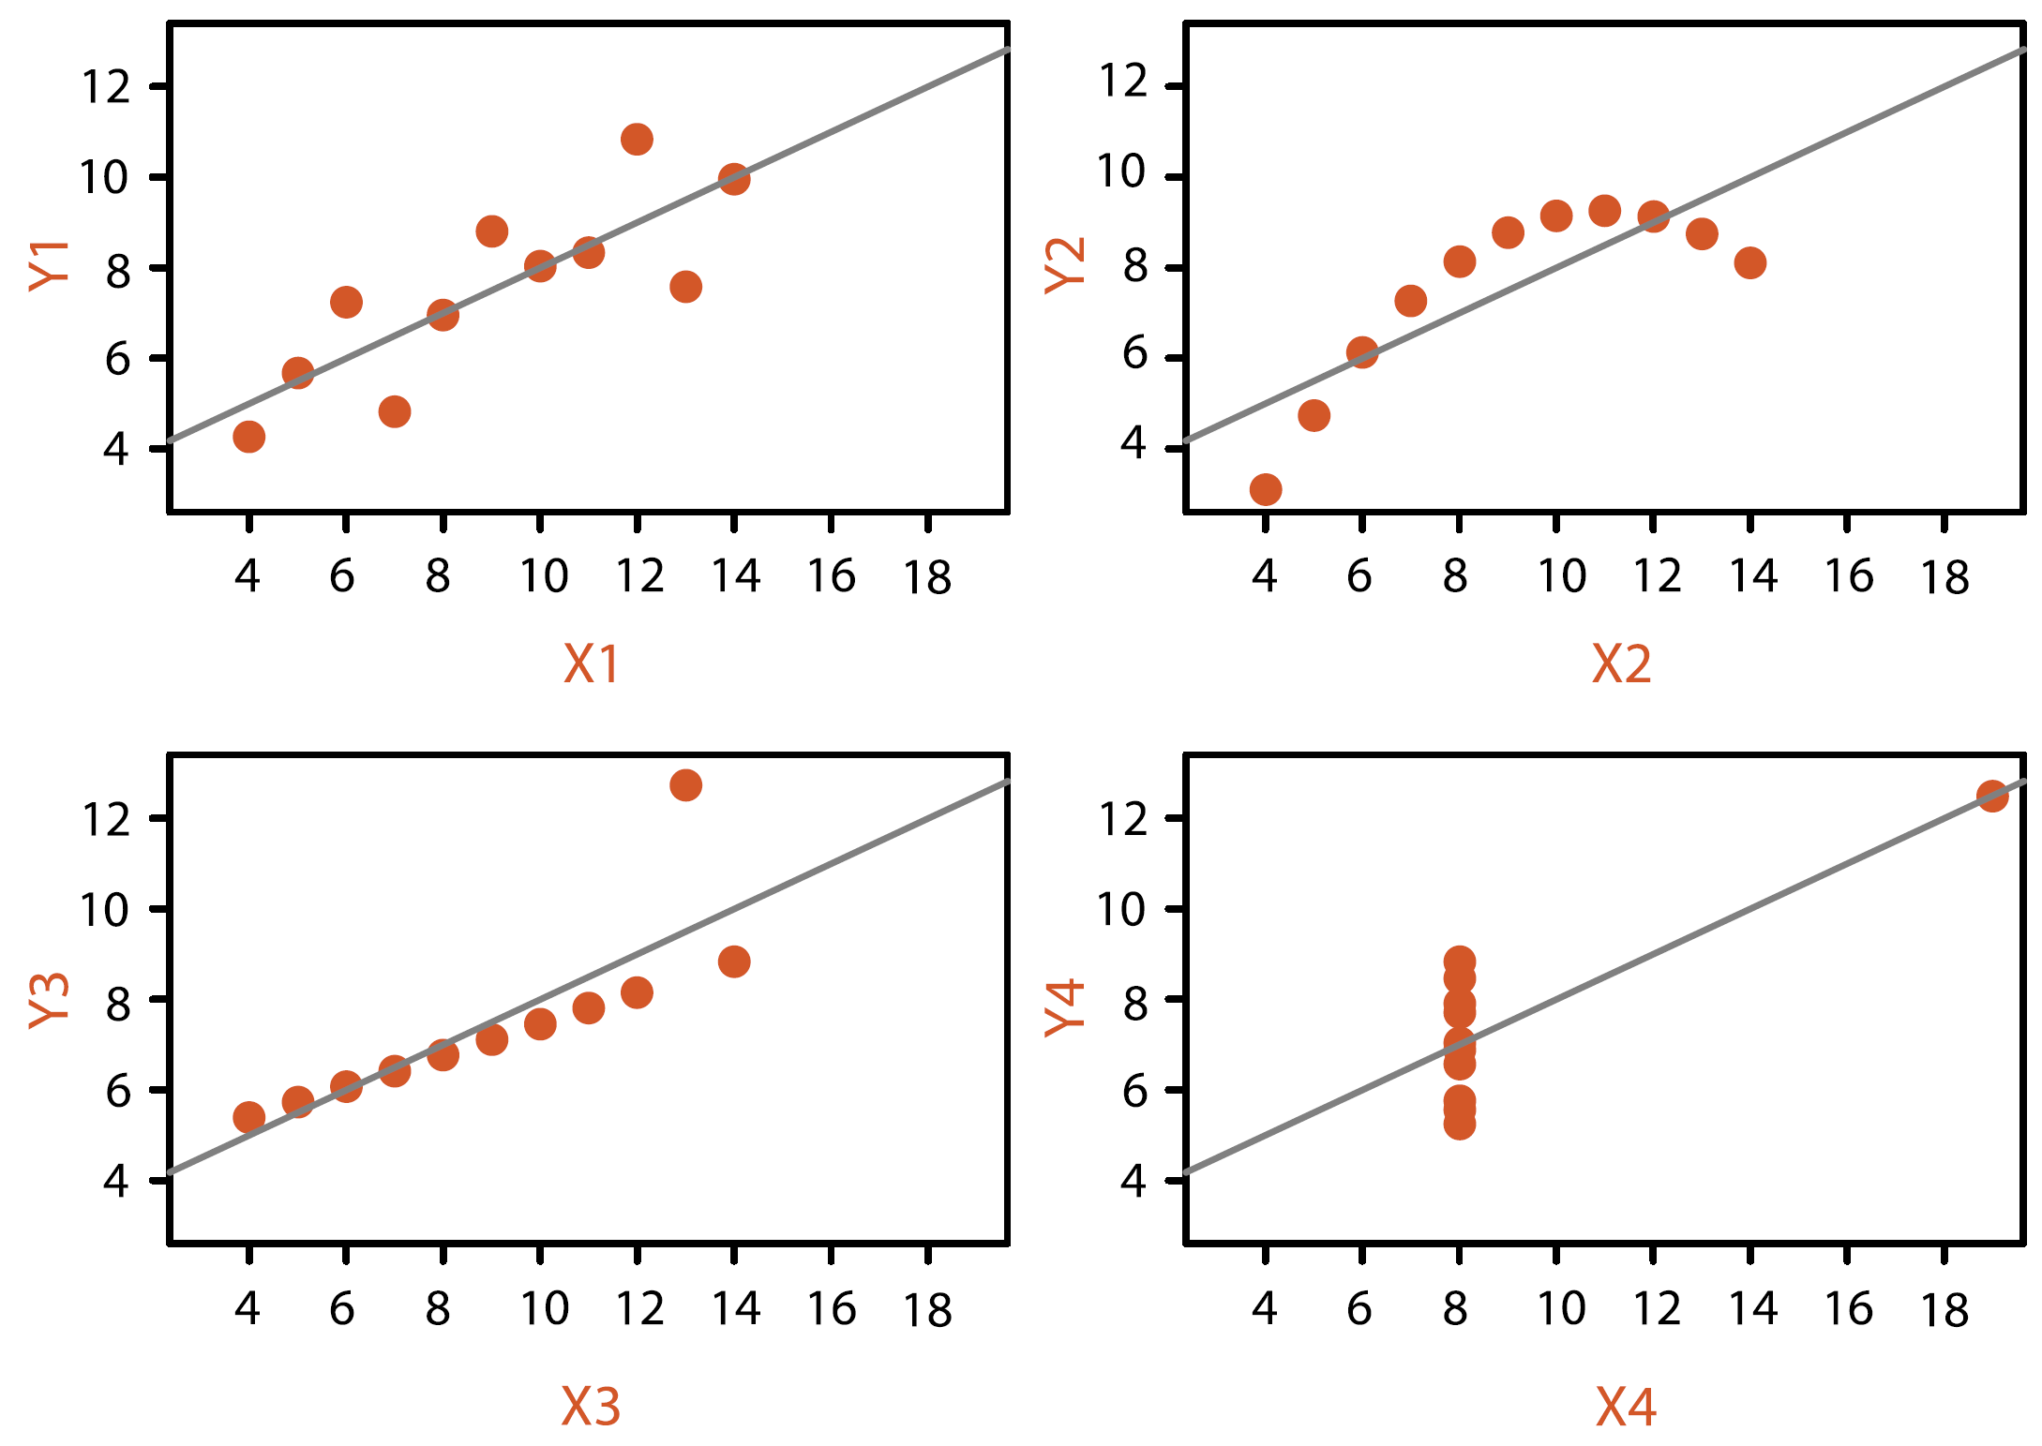
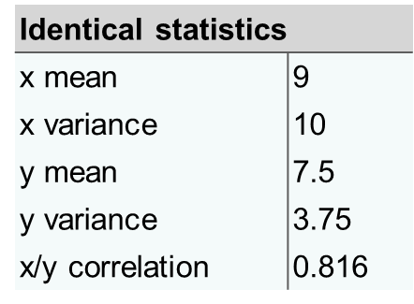
Represent All the Data
Summaries lose information and hide the true structure of the dataset, details matter
Anscombe’s Quartet
Same stats, different graphs

Slide 28
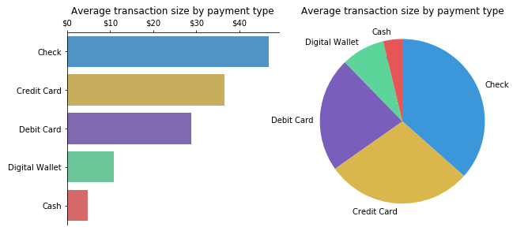
Focus on Tasks and Effectiveness
A vis tool that serves well for one task can be poorly suited for another
E.g., Identify exact value vs. Part to whole relation
Effectiveness: defining the right vis to support user tasks
“It’s not just about making pretty pictures”
Design vis based on user requirements

Slide 29
How to Get User Requirements?
Design Thinking Process
An iterative, non-linear process which focuses on a collaboration between designers and end-users
Learn about users through testing
Test creates new ideas for the project
Empathize to
define the
problem
Empathize
Define
Ideate
Prototype
Test
https://www.justinmind.com/blog/design-thinking-process-ux-design/
Learn from prototypes to spark new ideas
Test reveals insights that redefine the problem
Notes:
Design Thinking tackles complex problems by:
Empathizing
Understanding the human needs involved
Defining
Re-framing and defining the problem in human-centric ways
Ideating
Creating many ideas in ideation sessions
Prototyping
Adopting a hands-on approach in prototyping
Testing
Developing a prototype/solution to the problem

Slide 30
How to Get User Requirements?
Iterative Human-Centered Design Process
Observation (observe and understand user needs/problems)
Idea Generation (collect possible solution ideas)
Prototyping (develop selected ideas)
Testing (get end-user feedback)
Design of Everyday Things, by Don Norman
Chapter 6: Design Thinking
(Norman 2013)

Slide 31

Resource Limitations
Vis designers must consider three very different kinds of resource limitations: those of computational, humans, and displays
Computational limits
Scalabality (memory, handling large datasets)
Performance (processing time)
Human limits
Human perceptual and cognitive capacity
Display limits
Pixels are precious resource, the most constrained resource
Information density: ratio of space used to encode info vs. unused space

Slide 32
Human Limitations
Humans are limited in their capacity
They have lousy memory
Don’t always see everything
Get confused of too many things
Get tired and bored
Don’t always pay attention
Get easily distracted
This has important implication for visualization design
Designers needs to take all this into account

